Slide 1


Welcome!
Thank you for your patience. We will start in a few moments.
The Private Sector and Digital Health Solutions: Expanding Access to Quality Family Planning /Reproductive Health
November 13, 2022

Slide 2
The Private Sector and Digital Health Solutions: Expanding Access to Quality Family Planning /Reproductive Health
November 13, 2022

Slide 3
The Private Sector and Digital Health Solutions: Expanding Access to Quality Family Planning /Reproductive Health
Panel 1: Business Approaches

Slide 4


Panel #1 - Business Approaches
Moderator: Rodio Diallo Senior Program Officer
Bill & Melinda Gates Foundation
Rodio Diallo leads the private sector pharmacy and drug shop bodies of work portfolio to expand contraceptive access and uptake in the Gates Foundation priority geographies for family planning. She is the technical support for Family Planning working with the Foundation’s Africa Regional Office (ARO) and family planning initiative teams, working from Abuja, Nigeria.
rodio.diallo@gatesfoundation.org

Slide 5




Panel 1: Business Approaches
Meet our panelists
Natacha Mugeni:
Director of Health Operations at Kasha, a femtech platform for women’s health and self-care in East Africa
natacha@kasha.co
Chidinma Onuoha:
Director for Honey & Banana integrated digital ecosystem and Program Director with DKT Nigeria
chidinma@dktnigeria.org
Josselyn Neukom:
Senior Vice President at SwipeRx, overseeing pharmacy-focused digital health programs and research across six countries in Southeast Asia
josselyn@swiperxapp.com
Ben Bellows:
Co-founder and Chief Business Officer at Nivi, a digital health marketplace in India, Kenya, and Nigeria
ben@nivi.io
For more detailed bios, please visit: https://icfp2022.org/private-sector/

Slide 6


Honey & Banana is an integrated digital ecosystem
Promotes SRH services and products in both the private and public sector
Leverages digital technologies of call centre, social media platforms, apps, websites to improve awareness, accessibility, and acceptability of FP and SRH services among vulnerable populations
Corporate culture emphasizes entrepreneurialism, results-oriented (B2B/B2C) business model measured with clear metrics around health impact, decentralized organizational structure with a high degree of authority and autonomy and a de-medicalized, sex-positive, and fun approach to the mission
Growth stage (9 years operation in Nigeria) working towards sustainability

Slide 7
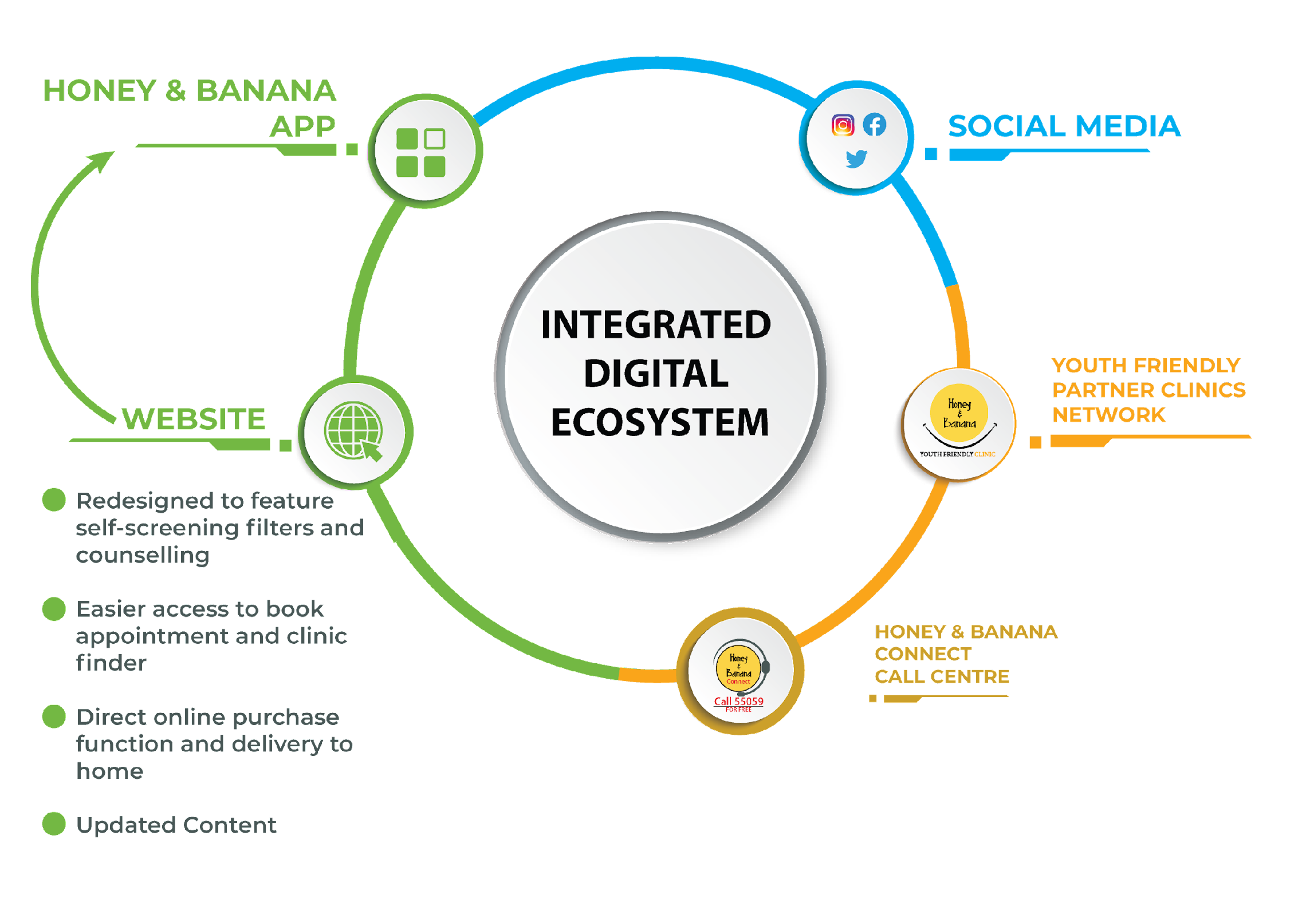
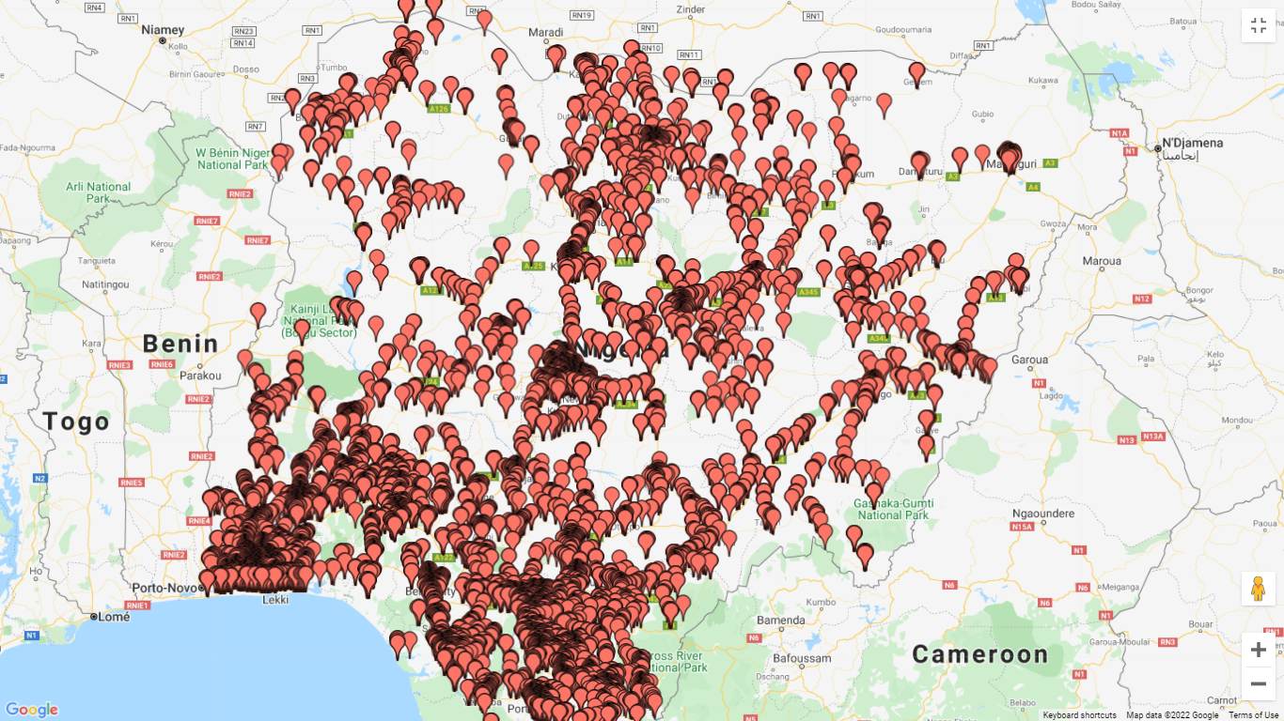
Honey & Banana Digital Platform
+70,000 Service Points (PPMVs, hospitals, etc.)
.

Slide 8






Nivi creates value from connecting consumers to health information, services, and products
Health Educators
such as NGOs
can efficiently communicate
with and serve beneficiaries
Service & Product Providers
such as pharmacies
can engage and expand
their customer base
askNivi
a marketplace driven by conversation enabling
Health Consumers
empowered for self-care & self-reliance
Health Payors
such as insurance funds
can cover more
population segments
Health Awareness
Uptake of Products & Services
Manufacturers
such as pharma
can access real-time data on
consumer demand patterns & behaviors
Data on Consumer
Demand & Behaviors
Notes:
Enter askNivi, the conversational marketplace that helps these actors improve the delivery of health services by allowing them to -
Raise awareness on a health topic
Educate, activate, and refer consumers to products and services
Get realtime insights on consumer demand and behavioral patterns that can inform marketing programs, and provisioning of products

Slide 9
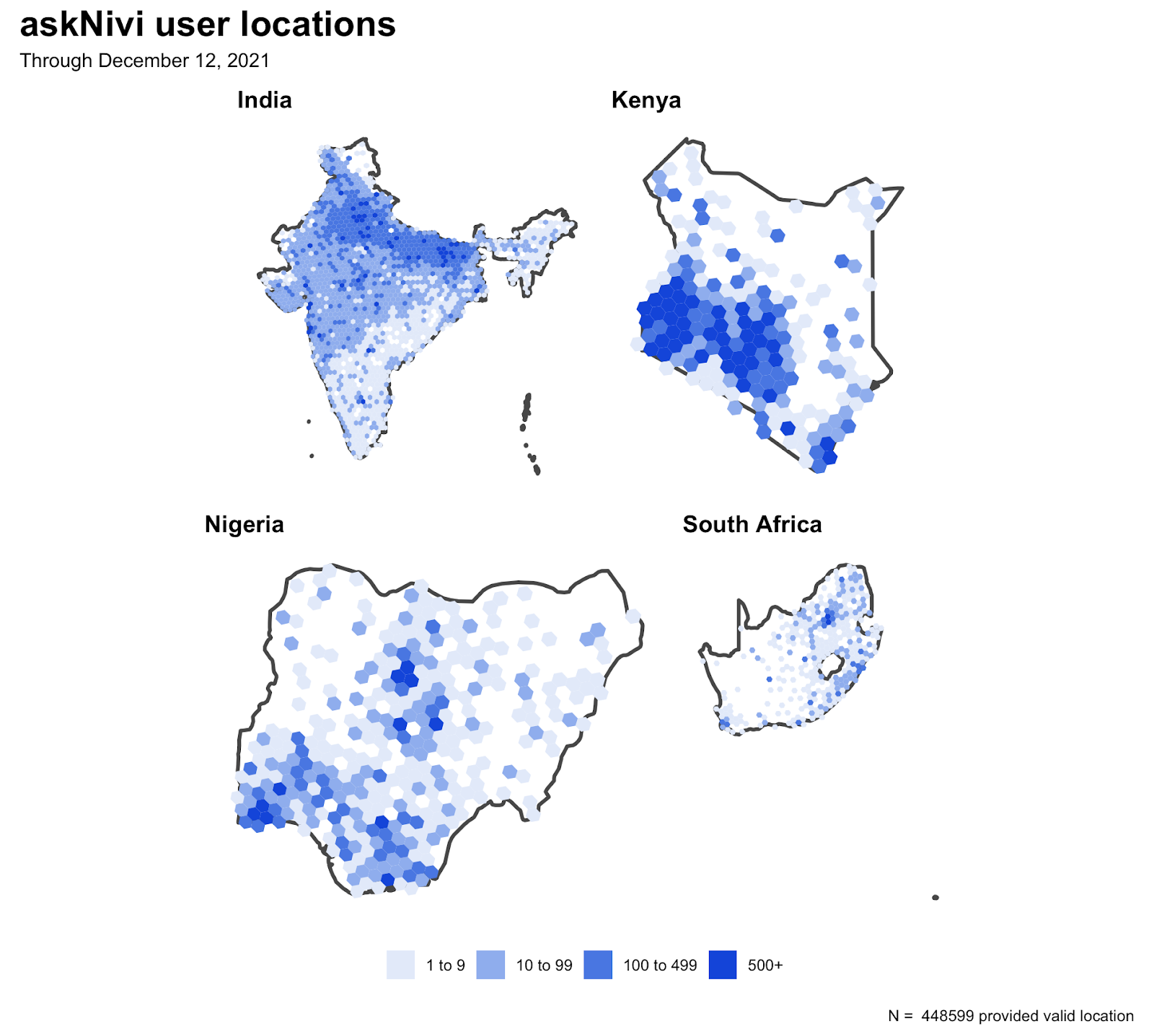












Nivi digital health marketplace: Achieving FP/ SRH outcomes
Nivi Impact
B2B2C Digital health marketplace in India, Kenya, and Nigeria
3MM conversations served
11+ health journeys in SRH, MHC, PHC domains
14,385 service providers
7.6 million data points
Nivi Performance
Nivi Insights

Slide 10
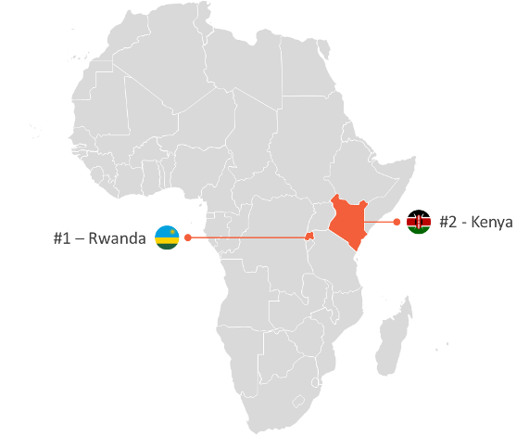
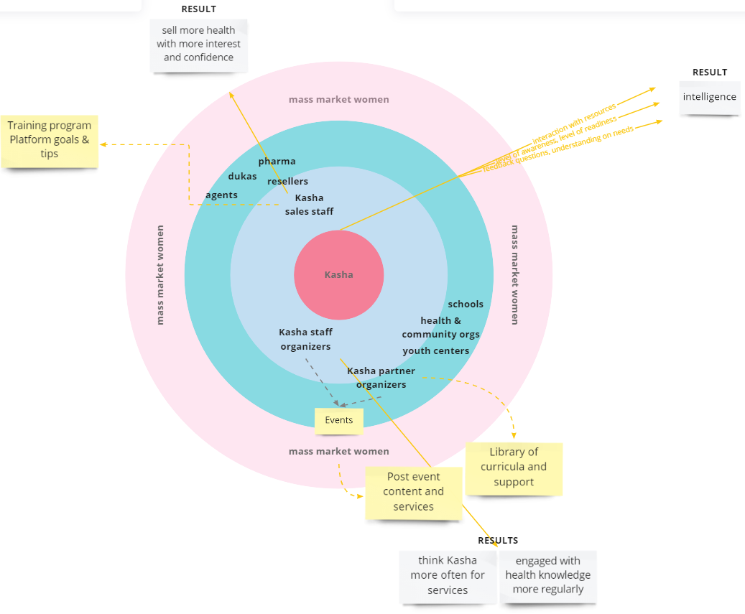










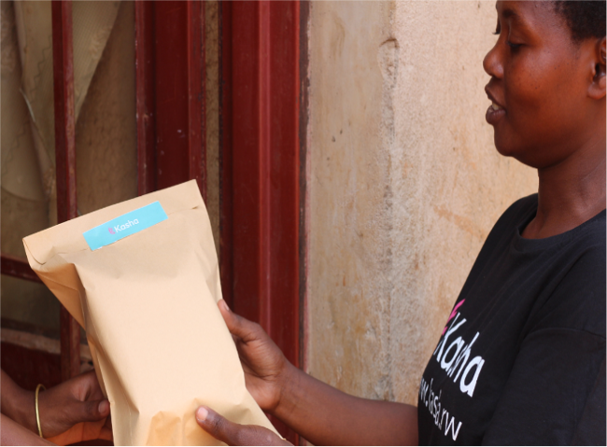

Kasha is an e-commerce business serving women in East Africa
Online & Offline Platform
Optimized for
Women’s Health &
Self-Care Products
Last Mile Delivery to Urban and Rural

Slide 11

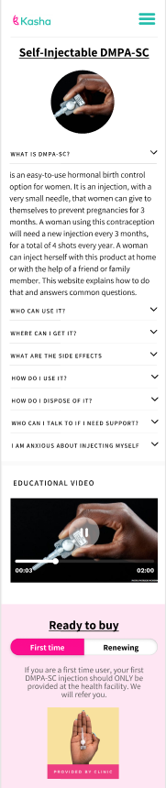


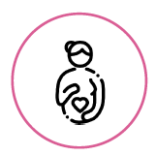
Kasha’s impact spans information, products and women
Access to Health Products
500,000+ Unique Customers
15,000,000+ Product Units Sold
70% Rural Customers
2,500+ Kasha Agents for
Last Mile Distribution
Access to Health Information
Employment & Improved Livelihoods for
Low Income Women

Slide 12








SwipeRx is an All-in-One app for Pharmacy Professionals
Created in 2017, SwipeRx is the largest digital network of pharmacy professionals in Southeast Asia and currently connects 240,000 users, of which 61% identify as women, from more than 55,000 pharmacies across the region
Accredited professional
education
Games, Polls & Surveys
News and announcements
Drug Directory
Community of practice
Tracking & reporting
e-Tools to improve pharmacy practices
B2B Commerce

Slide 13


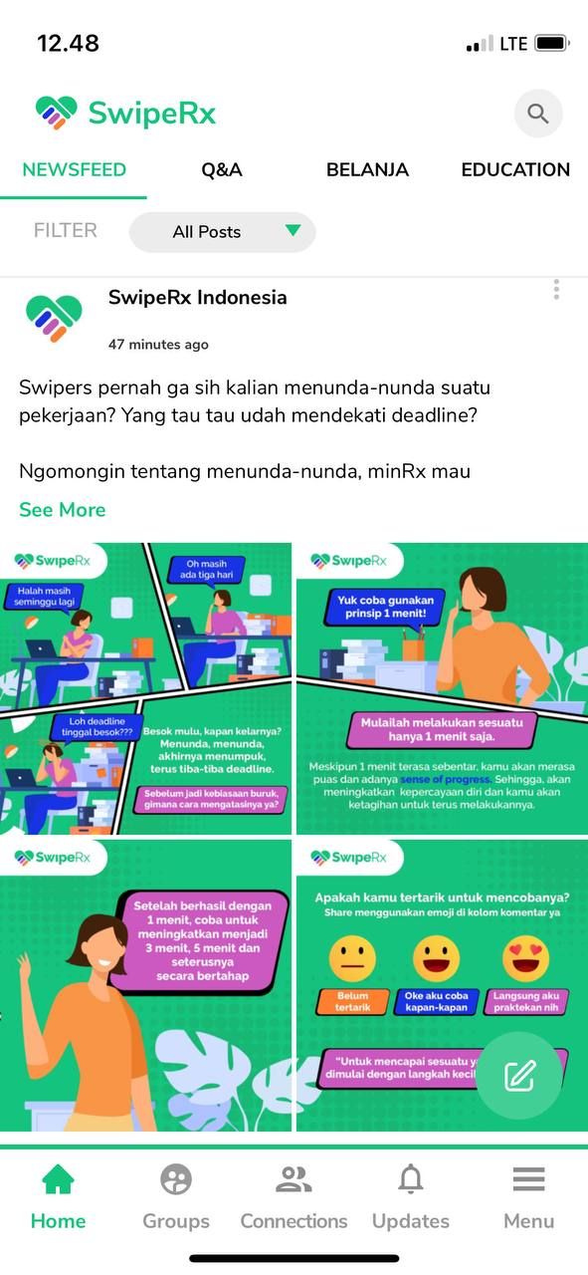


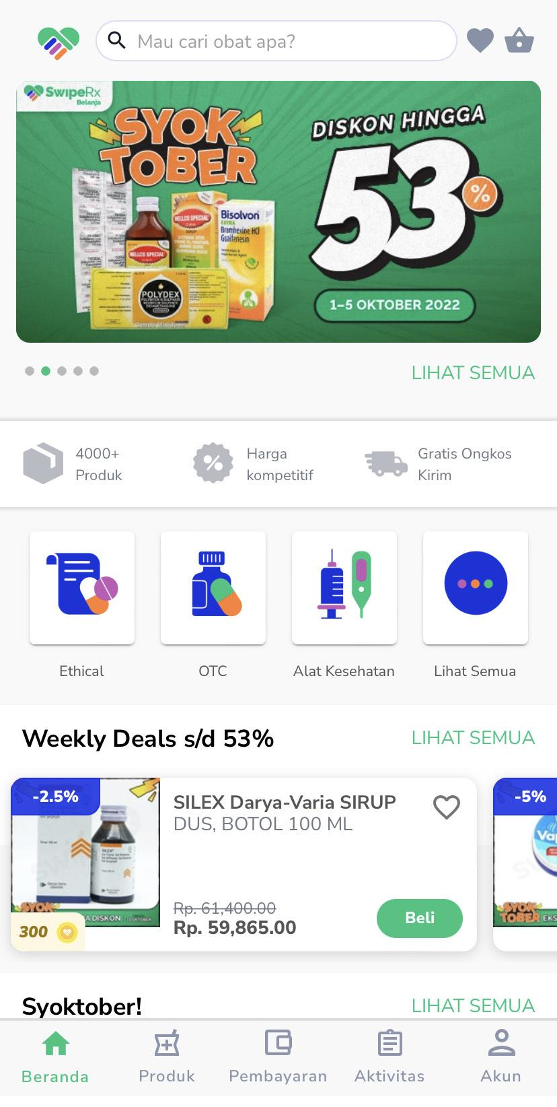


SwipeRx enables commercial & global health partners to engage pharmacies at scale and speed not previously possible.
Business Model
GLOBAL HEALTH PARTNERS
MANUFACTURERS & DISTRIBUTORS
SwipeRx Community
SwipeRx Commerce
Research
Campaigns
Education
Customized Features
Supply Chain

Slide 14
Business Model Challenges
What are the main challenges your organization is encountering (or did encounter) in working towards a sustainable business model?

Slide 15
Opportunities
What are the main opportunities you see for private technology companies to improve reproductive health in LMICs?

Slide 16
Impact in Increasing Access to SRH/FP
Can you share examples or measures of impact in increasing access to SRH/FP services via your organization’s digital solution?

Slide 17
Policy Environment
What is the one policy change that could lead to a more enabling environment for the private sector to engage further in this space to build a sustainable business and achieve impact?

Slide 18
Thank you!
Natacha Mugeni:
natacha@kasha.co
Chidinma Onuoha:
chidinma@dktnigeria.org
Josselyn Neukom:
josselyn@swiperxapp.com
Ben Bellows:
ben@nivi.io
Rodio Diallo:
rodio.diallo@gatesfoundation.org

Slide 19
The Private Sector and Digital Health Solutions: Expanding Access to Quality Family Planning /Reproductive Health
Panel 2: Policy and Partnership for Digital Innovation

Slide 20

Panel #2-Policy and Partnership for Digital Innovation
Moderator:
Ashley Jackson
Sexual & Reproductive Health Team Lead, Primary Health Care Program
PATH
ajackson@path.org

Slide 21




Panel 2:Policy and Partnership for Digital Innovation
Prof. Unnop Jaisamrarn:
Chief of the FP and RH Unit in the Department of OBGYN,
Faculty of Medicine at Chulalongkorn University in Bangkok, Thailand
Chair, Sexual & Reproductive Health Committee, AOFOG
dr.unnop@yahoo.com; Unnop.J@Chula.ac.th
Dr. Helen Blackholly:
Vice President and Technical Services Director, MSI
Helen.Blackholly@MSIChoices.org
Vaibhao Ambhore:
National Program Manager for Family Health in India, PATH
avaibhao@path.org
Nene Fofana:
Executive Director, Africa Forward Advisory,
Founder, Africa Forward Foundation
nenefofana@africafwd.org
For more detailed bios, please visit: https://icfp2022.org/private-sector/

Slide 22

Policy and Partnership for Digital Innovation
TEEN CLUB THAILAND
Unnop Jaisamrarn
Bunyarit Sukrat
Sittipong Liamsuwan

Slide 23

WHY : High UIPs in Thailand
HOW: Social Media is trend
WHAT: Teen Club digital

Slide 24
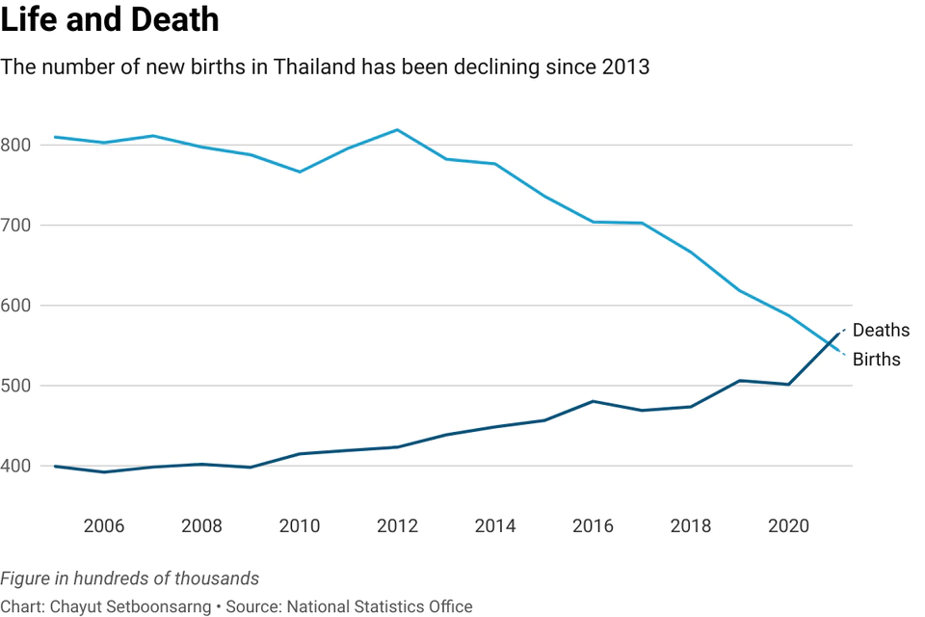
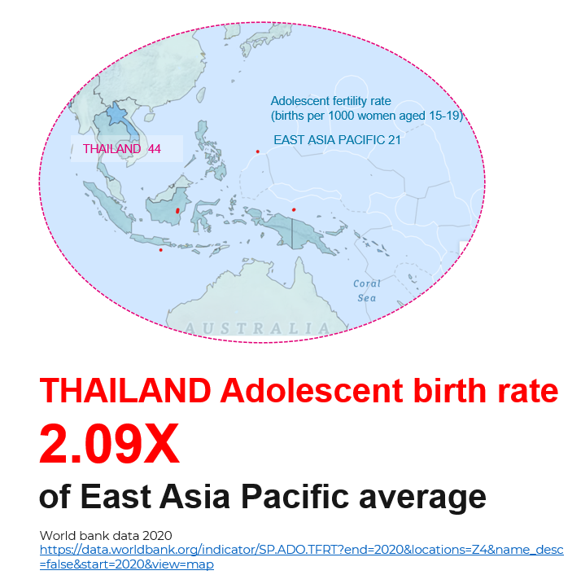
Thailand has Low Fertility Rate
BUT still has High Unintended Pregnancy
2021

Slide 25
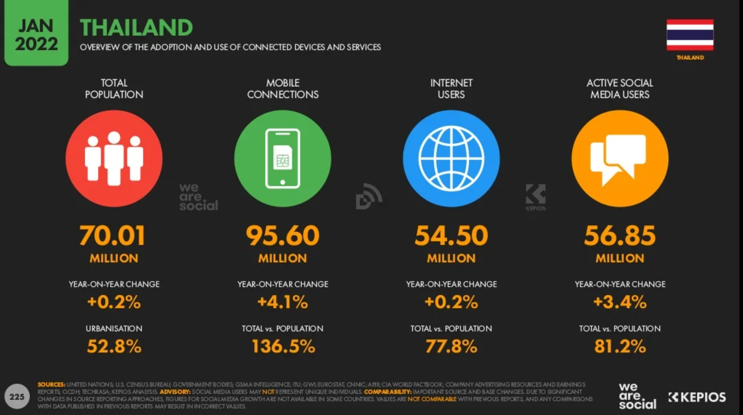
Digital is key trend in Thailand
80%
Internet Users
82%
Active on Social Media

Slide 26
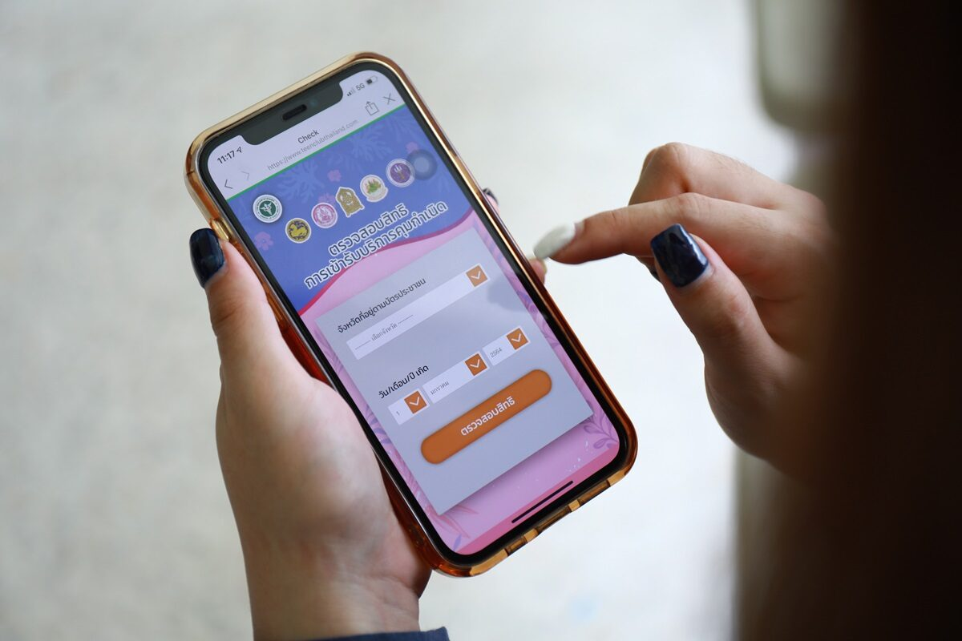

TEEN CLUB : Integrate Digital Solution
TEEN CLUB: Line Official Account
Platform for Information
Platform for FP Access
Platform for Consultation

Slide 27
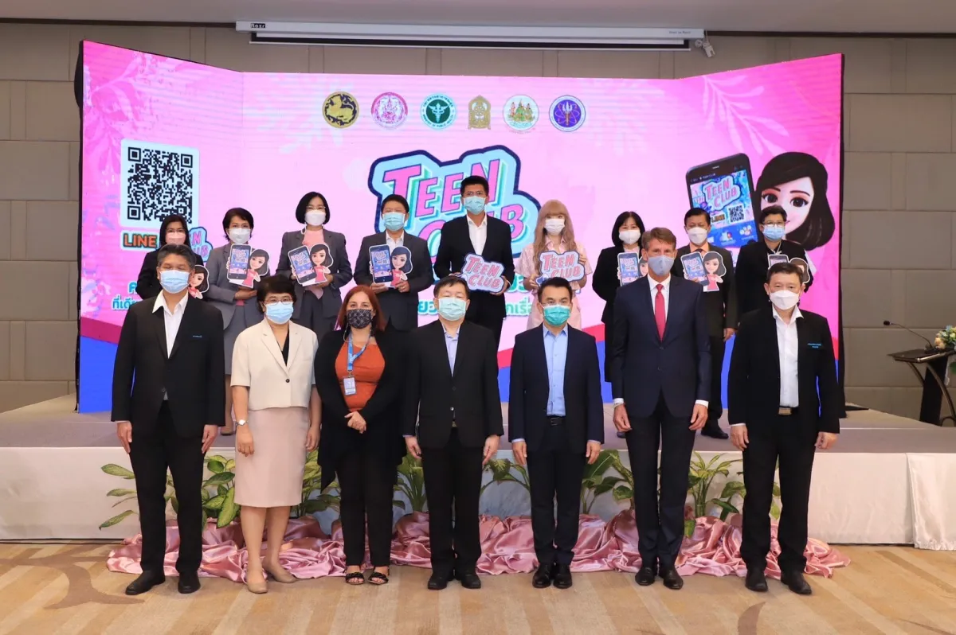
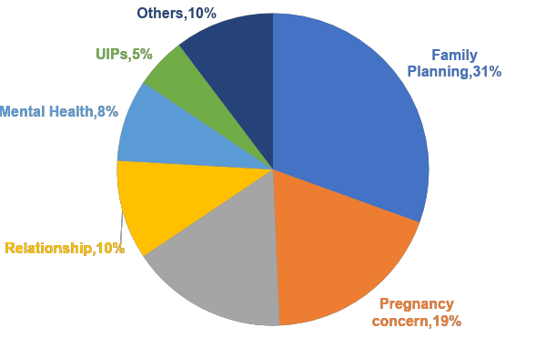
Key Success Factors are from Policy and Partnership for Digital Innovation
52,000 Followers
*as Oct 2022
# 2,582 consultations

Slide 28

Thank You

Slide 29
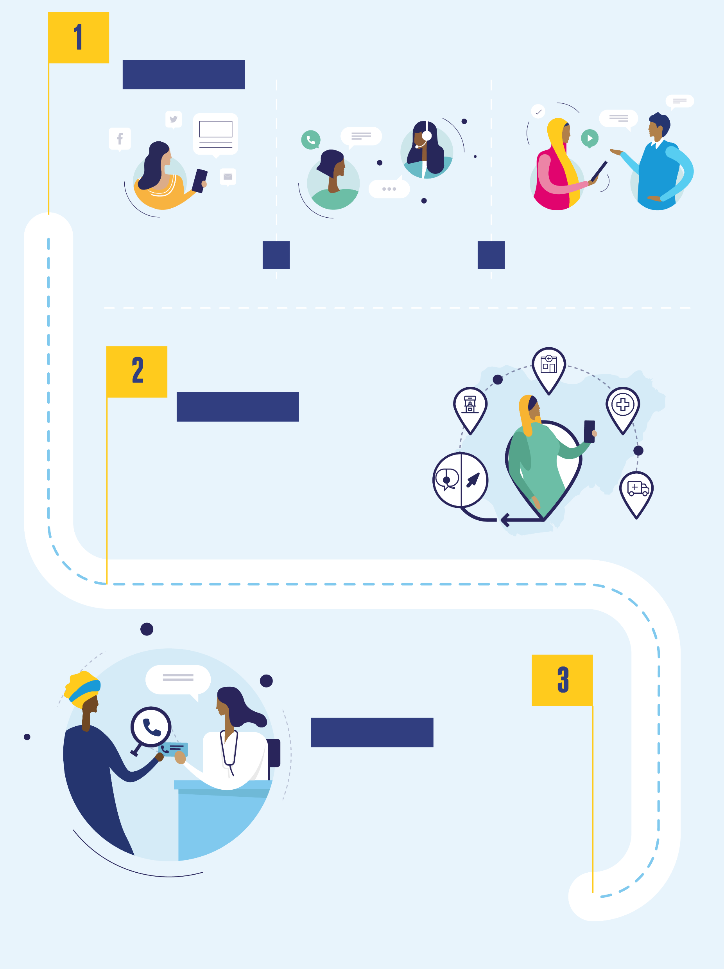
  PRIVATE SECTOR STRENGTHENING and role of ehealth
  To what extent does the lack of policy regulation or client trust affect telemedicine - mhealth acceptance and adoption?
Helen Blackholly
VP & Technical Services Director, MSI Reproductive Services
Policy and Partnership for Digital Innovation

Slide 30
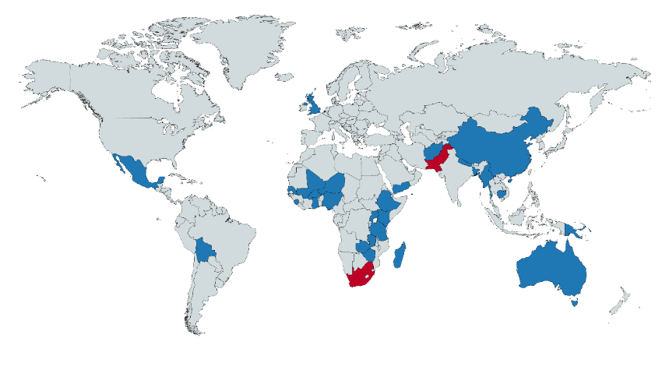


MSI Contact centre traffic has almost doubled since 2018, forecast to grow further
2.7 million interactions handled
42% via Social Messaging
41% of calls resulted in a referral for safe services
54% of all referrals were for FP & SA/PAC
In-house
Outsourced
33
+
300
30
* Interactions include inbound and outbound calls and social media messaging
Notes:
Operate at scale
We were at 1.54million interactions in 2018 – 92% growth
Growth in social messaging - Social media messages have risen from 26% to 40% of MSI contact centre interactions
Increasing online audience - Size of MSI's online audience (web and social media) is now over 1.7 million
Rise in phone ownership of clients -

Slide 31



“Burning platforms” help gain Government policy change
Burning platforms powerful drivers of strategic change.
MA provision in UK – handle nearly 400,000 calls year, 60,000 abortions, nearly 1/3 of UK abortions
Covid accelerated decision for telemedicine <10weeks
MSI developed telemedicine pathway within 1 week
Positive impact:
    improved waiting times (hybrid working helped)
    reduced average gestation time
    improved safeguarding
    did not impact complications or lead to any adverse effects
    majority of women preferred option of telemedicine
  Recommended by key influential bodies. Key for influencing UK Govt to make decision permanent
    Public consultation; Amendment to Health & Care Act, enshrined into primary legislation
    MSI UK trusted partner to Govt.
  National Institute for Clinical Excellence (NICE), the Royal College of Obstetrics and Gynaecologists (RCOG), the British Medical Association (BMA), World Health Organisation
Notes:
Burning platform – term came from an oil rig disaster in North Sea of England. Definite death if stay on burning oil rig, probable death if jump. But either way a decision has to be made. Covid – was a burning platform……They are what happens when:
There is a real and immediate crisis
There is a limited number of difficult and challenging choices
A decision has to be made

Slide 32

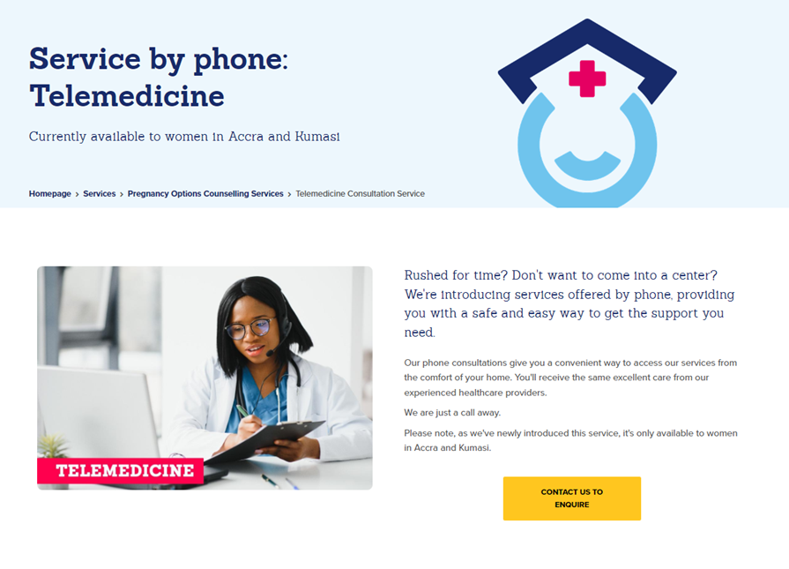
MSI Ghana leveraged “burning platform ”Covid19
Accelerated changes in policy, provision & acceptance
June 2021 Ghana Health Service (GHS) issued updated guidance allowing telemedicine for early medical abortion
July 21 MSI launched pilot
Speed enabled because of existing contact system & infrastructure
Government engagement & support
Notes:
Abortion in Ghana - legally permissible
Marie Stopes Ghana’s (MSIG) began providing contraception and safe abortion services in 2007 and continues to do so through diverse service delivery modes, including a network of private centres, mobile outreach teams, and through support to the public sector.​
MSIG’s Contact Centre is a key aspect of the service information and referral pathway offered by MSIG, providing clients with clear information and a pathway to care, as well as after-care follow-up​
Team of five Contact Centre agents handles an average of 140 calls a day, as well as multiple interactions on their various social media channels (including WhatsApp). ​

Slide 33

Telemedicine works – clients satisfied
1
40% calls where Telemedicine discussed resulted in MA consultation.
Once booked 87% took MA service
2
Social media and direct web adverts had highest impact on driving contact with “MarieCall”.
(Does take time to establish sufficient client reach).
3
High client satisfaction - 99% described their experience as good or very good with 76% rating it as ‘very good’. Overall net promotor score (NPS) of 79%
33

Slide 34
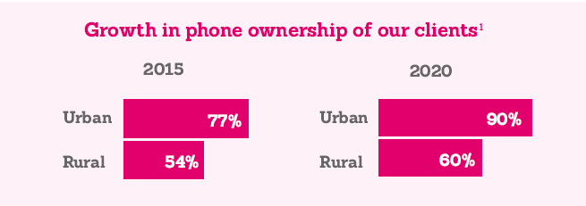
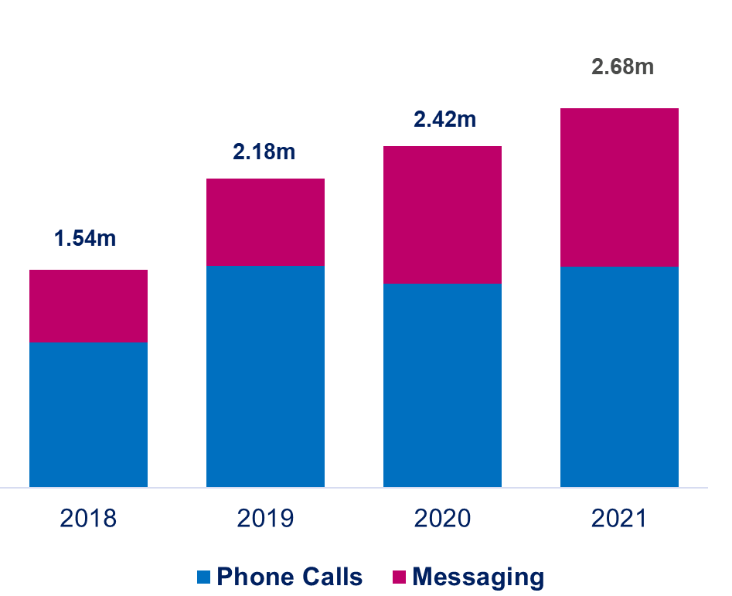
E-health is key enabler - needs infrastructure AND people to get right information to women
How to
Empower people with knowledge to take healthcare into their own hands
Growth in MSI Contact Centres Traffic
Conversations with contact centre agents help clients make informed choices, dispel myths, misconceptions
Multi-platform contact
Access confidential advice
LARC uptake higher
Deal with misinformation
Staying within regulatory rules
34
Notes:
There is NO shortage of information – question is – is it right?
How do we get into hands of women to improve quality of care
Accessing sexual and reproductive health services can be a stigmatised and intimidating experience in many contexts
Our contact centres help prepare clients for their visit, ensuring they leave us happier with their experience. Our contact centres can prepare women regardless of where they go for a service. More and more people have access to a phone and this is transforming how people want to contact us.
Add #s
We see in our centres – the benefit of haven spoken to an agent – starts the conversation. Someone who has spoken to CC beforehand 69% STRONGLY agree “likely to recommend” vs 54% who have not spoken before.
Translates into LARCs in DRC, Nigeria, Zim – LARC uptake all higher if have spoken to CC beforehand – DRC = 87% vs 65% LARC uptake
Supporting a continuum of care. Our contact centre’s mean clients can always reach us at any stage in their SRH journey, even after teams have left sites.

Slide 35
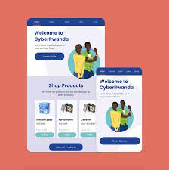





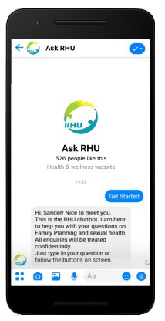

Collaborative partnerships help deliver right support
Expanding space
MSI is addressing this opportunity through digital partnerships
+ Introduction of a virtual assistant in our contact centres.
+ Integrated client journey
35
Notes:
MSI is addressing this opportunity through digital partnerships
Introduction of a virtual assistant in our contact centres.
Integrated client journey allows us to introduce more effective/streamlined referral tracking and routine outbound contact with our clients (multi-platform follow-up and reminders)

Slide 36
Governments can accelerate ehealth, clients trust it, but someone has to pay and systems need to connect
In Partnership
Operationally
Policy & Regulations
2x more tech enabled eHealth solutions in Africa¹
Growing evidence potential of ehealth – but needs more to reassure Governments & investors
User & HCP acceptance and adoption key prerequisites
Interoperability in technology
Generate evidence
Recognise & use “Burning platforms”
Pilot & develop mhealth protocols
Consistent regulations simplify & facilitate reimbursement; data privacy…
Incorporate into health insurance schemes
eHealth included in medical training & education
MSI vision: Where no woman is more than 1 contact away and no more than 1 hour away from a safe service
Salient Health 2021 vs 2019
Notes:
Growing evidence highlighting potential of mobile health (m or eHealth) in reducing health care costs, enhancing access, and improving the quality of patient care.
User & HCP acceptance and adoption are key prerequisites (deal with fears - confidentiality; loss of HCP credibility/autonomy….)
Interoperbility in technology: multiplatform, offer compatibility/link to service provision, easy, personalised & convenient. Cannot delegate all to chatbots…
Recognise & leverage “Burning platforms” : Provision of abortion transformed & accelerates when Governments have urgent need to provide services..

Slide 37
Thank you
For further information
Helen Blackholly, +447720549183
Helen.blackholly@msichoices.org

Slide 38
Q&A: Policy and Partnership for Digital Innovation
Prof. Unnop Jaisamrarn:
Chief of the FP and RH Unit in the Department of OBGYN, Faculty of Medicine at Chulalongkorn University in Bangkok, Thailand. Chair, Sexual & Reproductive Health Committee, AOFOG
dr.unnop@yahoo.com; Unnop.J@Chula.ac.th
Dr. Helen Blackholly:
Vice President and Technical Services Director, MSI
Helen.Blackholly@MSIChoices.org

Slide 39

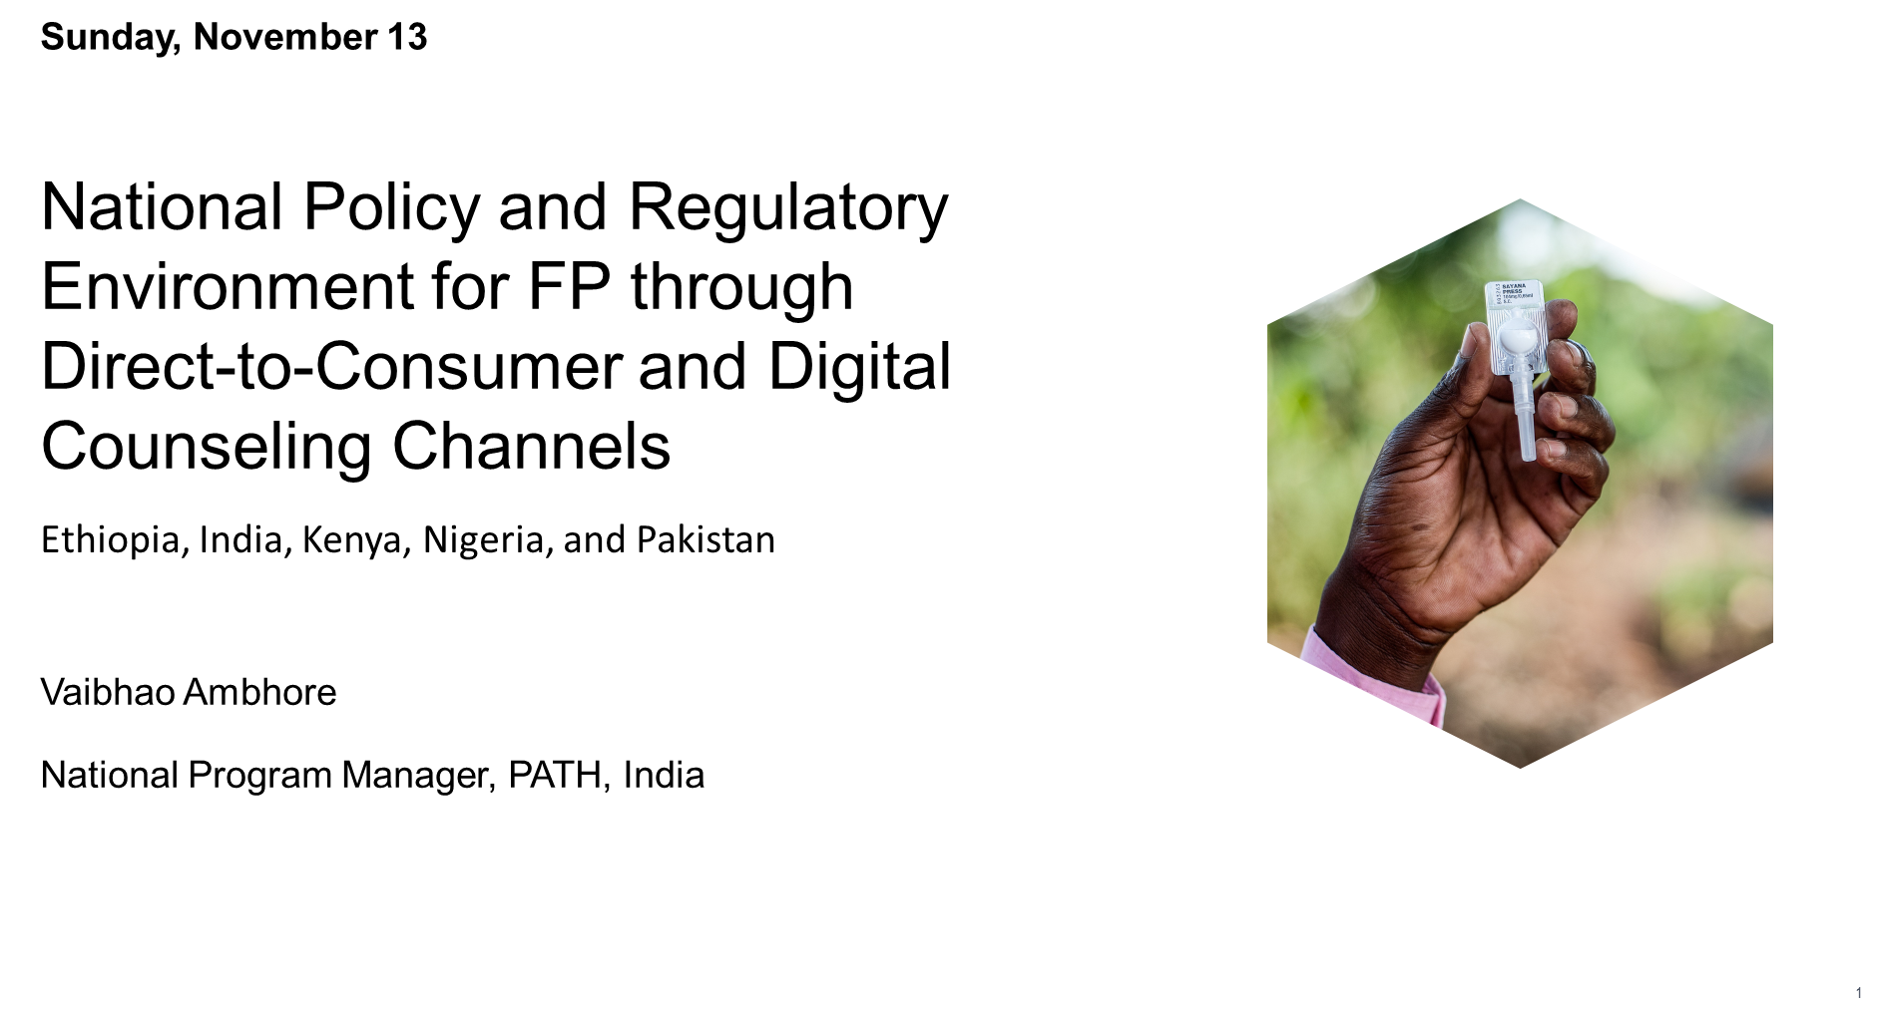


Slide 40
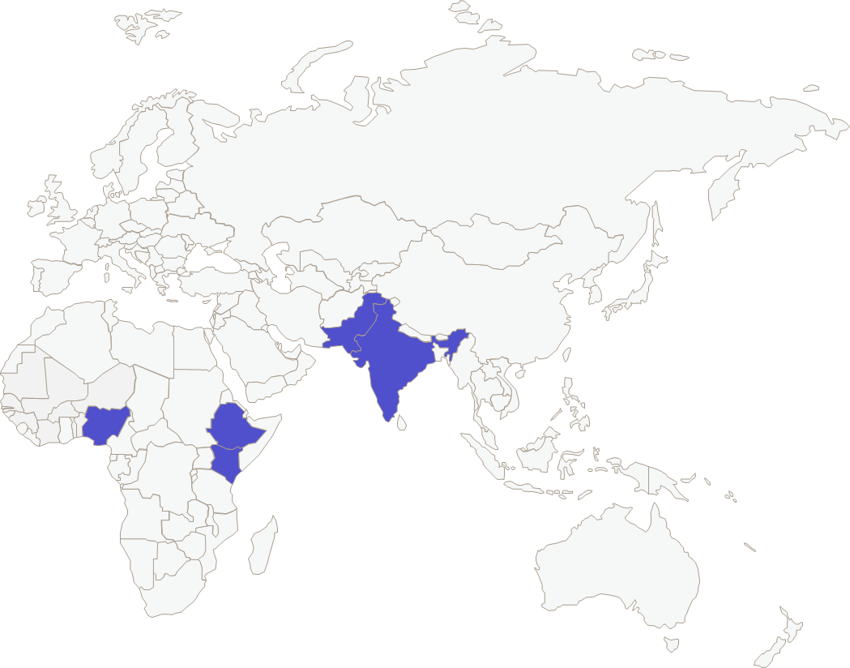
Project scope
PATH conducted a landscape analysis to inform policy and regulatory change for drug shops and pharmacies, direct-to-consumer (DTC), and digital counseling (DC) channels within select geographies: Ethiopia, India, Kenya, Nigeria, and Pakistan.
Methods:
Desk review of partner resources and national policies
Stakeholder consultations to supplement desk review
Identification of policy gaps and advocacy opportunities

Slide 41
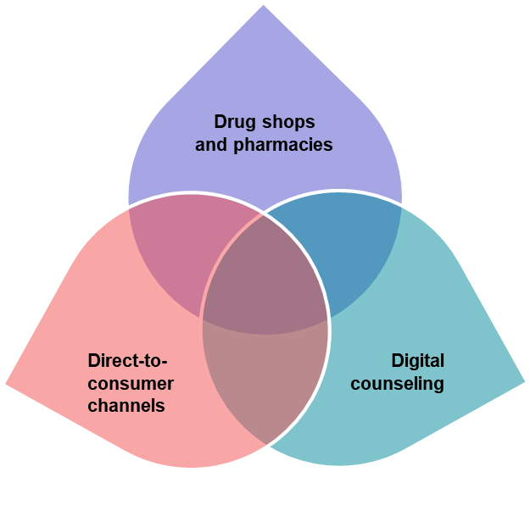

Context
Pharmacies are retail facilities that sell both prescription and over-the-counter medicines and are typically overseen by a licensed pharmacist. Drug shops are typically lower-level retail outlets that sell over-the-counter medications, and which usually do not have a licensed provider on staff.
Direct-to-consumer (DTC) channels sell products directly to consumers, without third-party retailers, wholesalers, and other “middlemen.” Common DTC channels include e-commerce websites (including e-pharmacies), apps, and direct sales by phone and door-to-door.
Digital counseling for FP can be defined as the provision of information and assistance in choosing a method that meets a woman’s needs and preferences using digital technologies and applications.
These three channels have natural areas of overlap from a policy perspective (e.g., regulation of e-pharmacies), and in some cases policies that enable one channel may also enable others

Slide 42
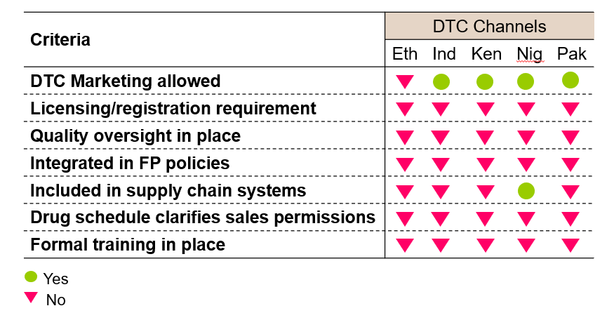
The state of the policy environment governing DTC channels, including e-commerce sites

Slide 43

The E-Commerce landscape in Nigeria
Significant growth in the e-commerce sector holds promise for direct-to-consumer channels, but policy work remains to ensure high-quality delivery via this and other channels.
E-commerce and other DTC channels do not appear to be regulated but are expected to align with the EML.
Infrastructure is a common barrier for e-commerce, especially in rural areas where poor roads limit delivery, and lack of access to financial services constrains digital payment.
Although self-care momentum and COVID-19 have increased demand for e-commerce, there is need for agenda-setting to generate political support.
Given the lack of regulation, significant advocacy is needed to expand policy and regulatory oversight of the sale of FP methods through this channel. It is important to consider whether these regulations may result in unnecessary restrictions.

Slide 44
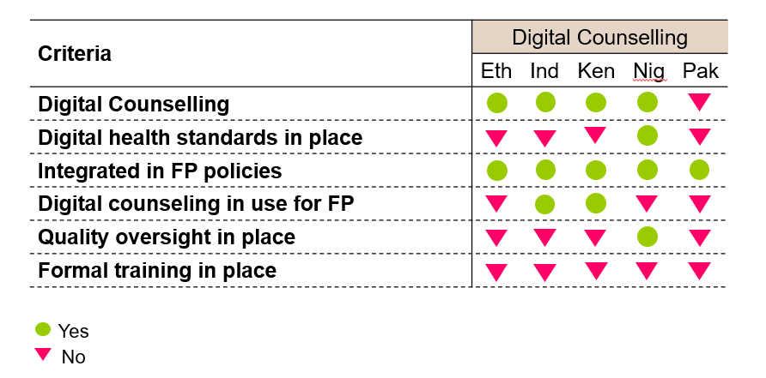
The state of the policy environment governing digital counseling for family planning

Slide 45

The digital counseling landscape in India
The growth of telemedicine and e-commerce present important opportunities to expand access to FP in India.
However, the development of formal policies and guidelines have lagged behind private-sector practice, highlighting a need for greater agenda-setting and policy formulation to guide implementation and ensure quality of care.
In some cases, existing policies prohibit providers from prescribing over-the-phone, though some of these restrictions were lifted during COVID-19 and have yet to be reinstated.
The government is interested in expanding digital counseling but requires strong evidence to inform this decision. Evidence generation and/or translation of research findings could help to create an advocacy case.
Training materials for digital counseling during COVID-19 should be updated to include language on FP.

Slide 46
Key takeaways to enable expanded access to FP through e-commerce and digital counseling
Demand for seamless, low-touch access to FP options has grown, and much of the progress to meet that demand has come from private-sector actors.
E-commerce and digital counseling represent two rapidly expanding channels.
Few countries have comprehensive, clear and/or policies or guidelines for these channels, which undermines the potential to scale and fully leverage.
There exists a need for basic agenda-setting work in many countries to gain policymaker buy-in, given the novelty of interventions such as e-commerce and digital counseling Wherever possible, efforts to draft new policies governing new channels for FP, and FP in the private sector, should be aligned to efforts to strengthen the policy environment for PHC.
Expansion of e-commerce and digital counseling requires a mix of authorizing and operational policies to enable consumer protection, data security, privacy and confidentiality.

Slide 47

Policy and Partnership for Digital Innovation
Implications of government stewardship and health sector regulation on digital health solutions
Salient Advisory landscape study
Nene Fofana
Africa Forward Consulting and Foundation
Pattaya City, Thailand
November 2022

Slide 48
Lessons from an analysis of key opportunities to advance contraceptive care through digital approaches in Francophone Africa
  Landscape study on the potential for utilizing health technology (through private sector players) to increase access to quality family planning in OP countries: Burkina Faso, Cote d'Ivoire, and Senegal
    We spoke with some 40 key informants from the private sector, development organizations, and policy makers and regulators.

Slide 49
Government stakeholders recognize a need to move toward digitally-enabled delivery, in the private sector, but the lack of a regulatory framework and limited insight into other countries’ policies are leading concerns
Regulatory authorities (e.g., ANRP), ministries of health (e.g., Burkina Faso DSF, Senegal DSME) and the ordre des pharmaciens in all three countries recognized the value of e-pharmacy.
They agreed that a pilot project is a potential approach to shift regulations.
They expressed a desire to first develop a regulatory framework and institute accountability and oversight mechanisms
Two stakeholders (Ordre des pharmaciens du Burkina Faso and Senegal DPM) without prompt asked about other countries’ e-pharmacy policies.
“Donors can help us not only with funds, but with expertise. We [the ordre des pharmaciens] would be happy to learn from other countries in Africa and around the world… We would also appreciate a sub-regional approach.”
– Ordre des pharmaciens, OP country
Notes:
While these key stakeholders recognize the need and importance of having digitally enabled delivery of medications, they expressed a number of shared concerns, mainly related to ensuring product quality, supply chain oversight, and how it might affect patient care. As such, stakeholders would like to develop a thorough regulatory framework and establish oversight and accountability mechanisms beforehand.

Slide 50

Medications are generally not sold online in the OP countries due to a restrictive regulatory environment. Although none of the countries has regulation that explicitly prohibits the online distribution of medications, several laws impede this practice
Policies, laws, and regulations |  | Implications
Public health and/or SRH code: The code specifies the conditions and rules for the practice of pharmacies and pharmacists. This includes requirement such as medications must be sold from pharmacists to patients. It does not include any language about digital services. |  | In conjunction with other relevant pieces of regulation, the health code will have to be updated to reflect new requirements around digitally-enabled healthcare delivery.
Advertising code: Countries often prohibit pharmacies marketing medical products to the public. |  | Online pharmacy may be perceived as advertising due to the public nature.
General regulation of pharmacies: Pharmacies must meet requirements for size, placement, and staffing. Exchange of pharmacies' ownership is also regulated. |  | If e-pharmacies exist separately from physical pharmacies, requirements will need to be defined.
Code of pharmacy practice: Explicitly bans “unfair competition”, defined as any practice that restricts a client’s choice of pharmacy. May further ban medical procedures. Lays out expectations for quality of care and counseling provided in the pharmacy. |  | Online distribution may be perceived as an “unfair advantage” unless all pharmacies can sell online. Any efforts must include a robust plan for ensuring that women are offered counseling.
Data protection and cybersecurity: Specific laws and level of enforcement varies by country. In all countries, preventing the sale of substandard and falsified medications is a priority. |  | Compliance with laws around general data security and patient protection, and a system will need to be in place to verify websites and products.
All three countries reviewed have very similar system modeled after pharmacy in France and the French 1954 decree on public health, suggesting that regulatory reform, adopting a harmonized approach, to enable online distribution may be possible.
Notes:
No medications are sold online given the restrictive regulatory environment in the focus countries. Across the focus countries, there were no specific regulation that explicitly prohibits online distribution of medications, but a number of laws prevent this practice.
We found that the three focus countries have very similar regulatory and pharmaceutical systems, as they modeled after the practice in France and the French decree. Each of these laws constraint specific aspect of online distribution, as detailed in the column on implications. However, the similarities of regulations across the focus countries present an opportunity for harmonization.

Slide 51
The situation with telemedicine appears more hopeful as the countries have recognized the need for digital health development in that regard, and are in the process of developing policies and regulations for telemedicine. Digital counseling, by contrast, does not appear to be an area of regulatory concern
 | Côte d’Ivoire |  | Burkina Faso |  | Senegal
National strategic plan on digital health | 🟢 | The national e-health strategic plan points out the lack of legal provisions relating to the use of information communication technology in health at the time. | 🟢 | The national e-health strategic plan identified priorities for digital health development and estimated financial need for the implementation of the major priorities. | 🟢 | The e-health strategic plan’s priorities included telemedicine. However, execution of the plan have been limited.
 | Digital health has been described as a priority based on the national strategic plan in each country.
Telemedicine regulation | 🟢 | The regulation for telemedicine was established in 2018 by MOH. Telemedicine centers must have an agreement to respect the national telemedicine plan. | 🔴 | No regulation. Not mentioned in any national strategic document. | 🟡 | The Digital Health Unit within the MOH has been drafting a digital health law to regulate the digital health sector, including interoperability of systems and telemedicine, with the objective to publish in late 2022.
Digital counseling regulation | No existing or planned regulations were identified as focused on digital counseling, and DC companies do not report any regulatory restrictions beyond general data privacy laws.
Though the digital health regulatory environment is under evolution in focus countries, regulation is not a barrier for digital counseling as digital counseling companies do not provide direct medical care (medical products or consultations with doctors). It is unclear whether regulators will step in when digital counseling companies grow.
Notes:
The reason we don’t focus on regulation here is because digital counseling doesn’t appear to be an area of regulatory concern. Governments are interested in digital health, they’re moving to regulate telemedicine, but no specific regulations focus on DC since it doesn’t involve the direct provision of regulated, medical care and products.

Slide 52


SUMMARY
Current regulations for digital delivery of family planning are highly restrictive and Health-focused DTC does not formally exist. Buy-in from several key stakeholders, particularly pharmacists, will be needed for regulatory reform.
Key stakeholders are interested in the potential of e-pharmacy, but concerns about product quality and patient safety would have to be addressed through a well-conceived pilot program involving private pharmacies.
Given that private pharmacies are individually owned in all countries with aggregation by the ordre des pharmaciens, who are key actors required for engagement
Notes:
Given our findings, we recommended to launch a regulatory learning group to focus on the role of online pharmacies to run pilot test in a key country through a grant to a regional partner. Through this support, cross-country learning can be facilitated, and resources provided to support regulatory reform. As regulations are similar across the countries, learnings can be shared to support eventually harmonizing the regulations.

Slide 53

PROGRESS/PROSPECTS
The BMGF recently approved support for the design of a multi-phased program covering 13 countries in Eastern and Western Africa, to work through a regional partner (to be selected), and launch a country-led demand-driven technical assistance program that will seek to:
convene regulators from interested countries
create a regulatory learning group focused on the role of online pharmacies
facilitate cross-country learning and
provide resourcing to support regulatory reform, including running a pilot in a selected country.
Notes:
Given our findings, we recommended to launch a regulatory learning group to focus on the role of online pharmacies to run pilot test in a key country through a grant to a regional partner. Through this support, cross-country learning can be facilitated, and resources provided to support regulatory reform. As regulations are similar across the countries, learnings can be shared to support eventually harmonizing the regulations.

Slide 54




Thank You! This analysis was led by Salient Advisory, with partnership from subject matter experts and a local health tech investment firm
Nènè Fofana is based in Cote d’Ivoire. Accomplished SRH Leader with experience in research, project management and health programming across the African continent. She has held roles as Senior Regional Advisor at PSI and Regional Advisor for West & Central Africa at EngenderHealth, where she coordinated program implementation and established a regional office in Côte d’Ivoire.
Dr. Placide Tapsoba, originally from Burkina Faso, is based in Ghana. He is a public health physician with extensive experience in large health program strategies, multi-sectoral partner support, strategic guidance and coordination, and leadership with particular focus on maternal, neonatal and child health and comprehensive reproductive health and rights. He was previously Ghana Country Director at Population Council and Regional Advisor for Francophone and West Africa at the Susan Thompson Buffett Foundation.
Médéa Degbe joins us from NORU Capital, an investment fund based in Senegal. NORU brings their deep knowledge of the financial and tech landscape in Francophone Africa, where they support a range of startups and small-to-medium enterprises, including through the Next Health Accelerator.
Notes:
this work has been conducted partnership with subject matter experts and local investment firms. Nene is based in Cote d’Ivoire and has led SRH projects across the continent for 18 years. Dr. Tapsoba is from Burkina Faso and based in Ghana. He has extensive experience in the Francophone region leading large health program strategies in MNCH. Medea works in Noru Capital and brings the investment fund’s deep knowledge of the tech landscape in Francophone Africa.

Slide 55
Q&A: Policy and Partnership for Digital Innovation
Vaibhao Ambhore:
National Program Manager for Family Health in India, PATH
avaibhao@path.org
Nene Fofana:
Executive Director, Africa Forward Advisory,
Founder, Africa Forward Foundation
nenefofana@africafwd.org

Slide 56
Policy and Public-Private Partnerships
What is one action government can take to support digital health solutions for FP in the private sector?

Slide 57
The Private Sector and Digital Health Solutions: Expanding Access to Quality Family Planning /Reproductive Health
Panel 3: Rights-based programming

Slide 58

Panel #3 Rights-based programming
Moderator: Lester Coutinho,
DKT International, Director of Innovation
Lester has championed sexual and reproductive health and human rights issues throughout his career DKT and at philanthropic institutions (David & Lucile Packard Foundation; Bill & Melinda GatesFoundation). Lester partners and advises governments and multilateral institutions to advance research, policy, and programmatic innovations in SRHR for sustainable impact. Lester is a former journalist and academic.
lester@dktinternational.org
“Advancing freedoms as the essential outcome of all development”

Slide 59


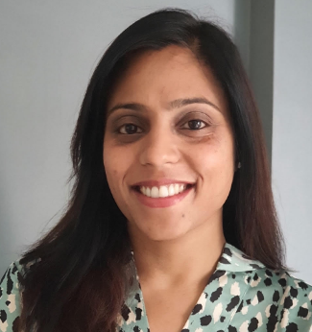
Panel #3: Rights-based Programming
Meet our panelists
Eszter Kismödi JD, LLM, is a human rights lawyer, specialized in SRHR law, policy, programming and research. She is the Chief Executive of SRH Matters, a WHO human rights advisor & a fellow at Yale & Harvard.
eszter.kismodi@gmail.com
Anne Philpott is a sexual health educator, practitioner, service
provider and pleasure propagandist! She established the digital Pleasure Project to promote safer sex and health. anne@thepleasureproject.org
Vithika Yadav is a human rights advocate & social entrepreneur, focusing on sexual & gender rights/global anti- slavery issues. Co-founded Love Matters India, a digital SRHR initiative & TeenBook. Top 120 under 40 New Generation of FP Leaders (2016)
vithika@devcons.org
For more detailed bios, please visit: https://icfp2022.org/private-sector/

Slide 60


Sexual and Reproductive Health Matters SRHM
Eszter Kismödi
Chief Executive
C A L L F O R P A P E R S S
Sexual and Reproductive Health Matters (SRHM) promotes sexual and reproductive health and rights globally.
Our open access, peer-reviewed journal provides an independent voice, has a longtime, trusted reputation, and offers a unique knowledge platform to a truly global network of researchers, policy makers, programme managers, lawyers and activists in the field of sexual and reproductive health.
SRHM’s core tenet is that sound, evidence-based and rights-grounded knowledge is of critical importance to the decisions to be made and the actions to be taken to improve sexual and reproductive health and rights.
D I G I T A L T E C H N O L O G Y A N D
S E X U A L A ND R E P R O D U C T I V E HEALTH AND RIGHTS

Slide 61
Rights-Based Programming: SRHR, digital technology and the private sector
Rights-based considerations for the private sectors include:
Equity and non-discrimination considerations, related the impact of digital technology on marginalised and structurally excluded populations and communities
How to establish responsible and transparent accountability mechanisms for the private sector, including in relation to collection, storage and sharing of SRH related data, privacy and protection measures,
Whether and how artificial intelligence and big data analytics can protect privacy, confidentiality, safety and security while broadening opportunities for efficiency and cost effectiveness within SRH interventions
Addressing barriers and protection measures within restrictive political, cultural, social, and legal settings – for example in criminalised settings and where access to and the provision of certain SRH services are stigmatised,
Development of rights-based laws, regulations and policies regulating the private sector in relation to digital technologies and SRHR
Digital technology can have multiple positive impacts on SRHR:
Extended access to SRH services reaching even the most marginalised, structurally excluded, and hard to reach populations,
Expanded availability of SRH information, counselling and products in restricted settings,
Strengthened accountability mechanisms and effective governance
Opportunity for communication, information sharing, movement organising and advocacy for SRHR advocates, activists and communities locally and globally.

Slide 62


.
Anne Philpott

Slide 63


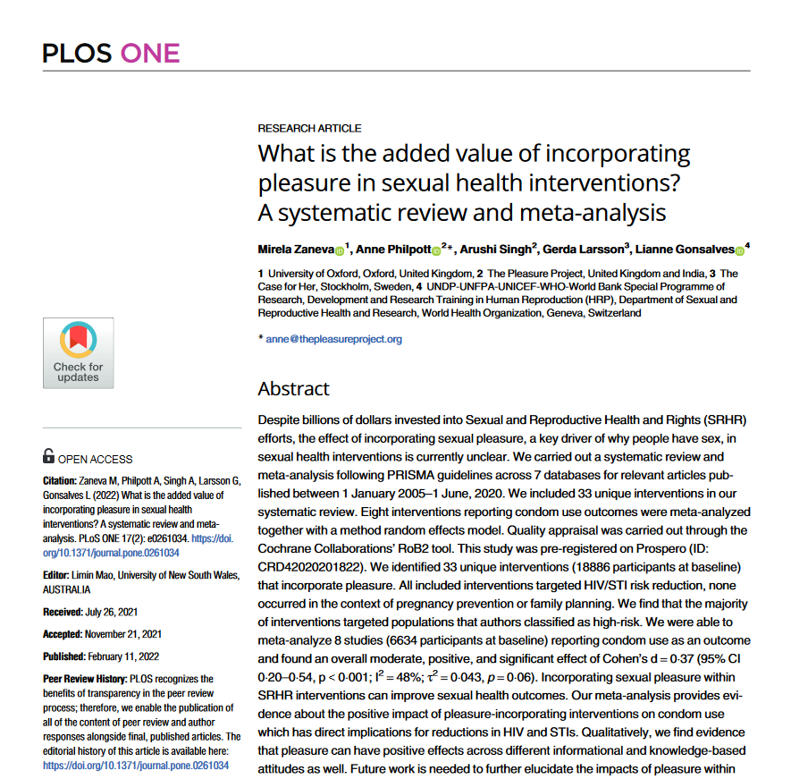



Picture captions

Slide 64

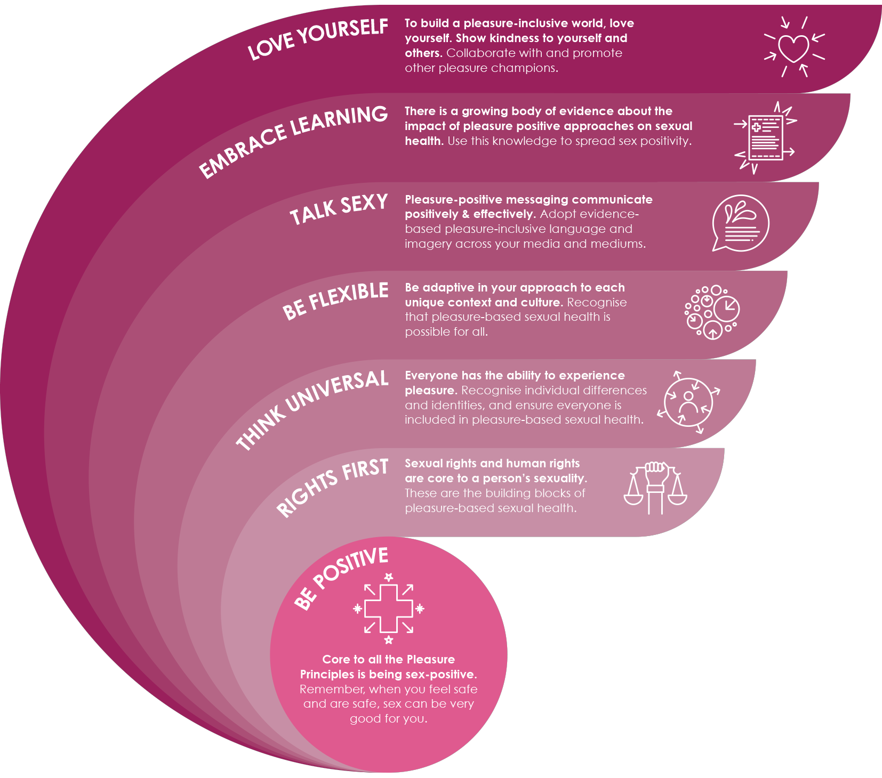

The Pleasure Principles
Pleasure-based Sexual Health
These Pleasure Principles are
designed to act as a guide and
inspiration to support people and
organisations to embark on the journey
towards a sex-positive, pleasure based approach to sexual health. The Pleasure Principles aim to help inspire and guide you as a pleasure activist, propagandist or practitioner.
Notes:
Would Packard Foundation be happy to endorse? Avert, IPPF, WAS, The Case For Her are endorsing.
Very aligned to your advocacy and policy work
Evidence gathering to support positive shifts in policy norms

Slide 65

Vithika Yadav

Slide 66
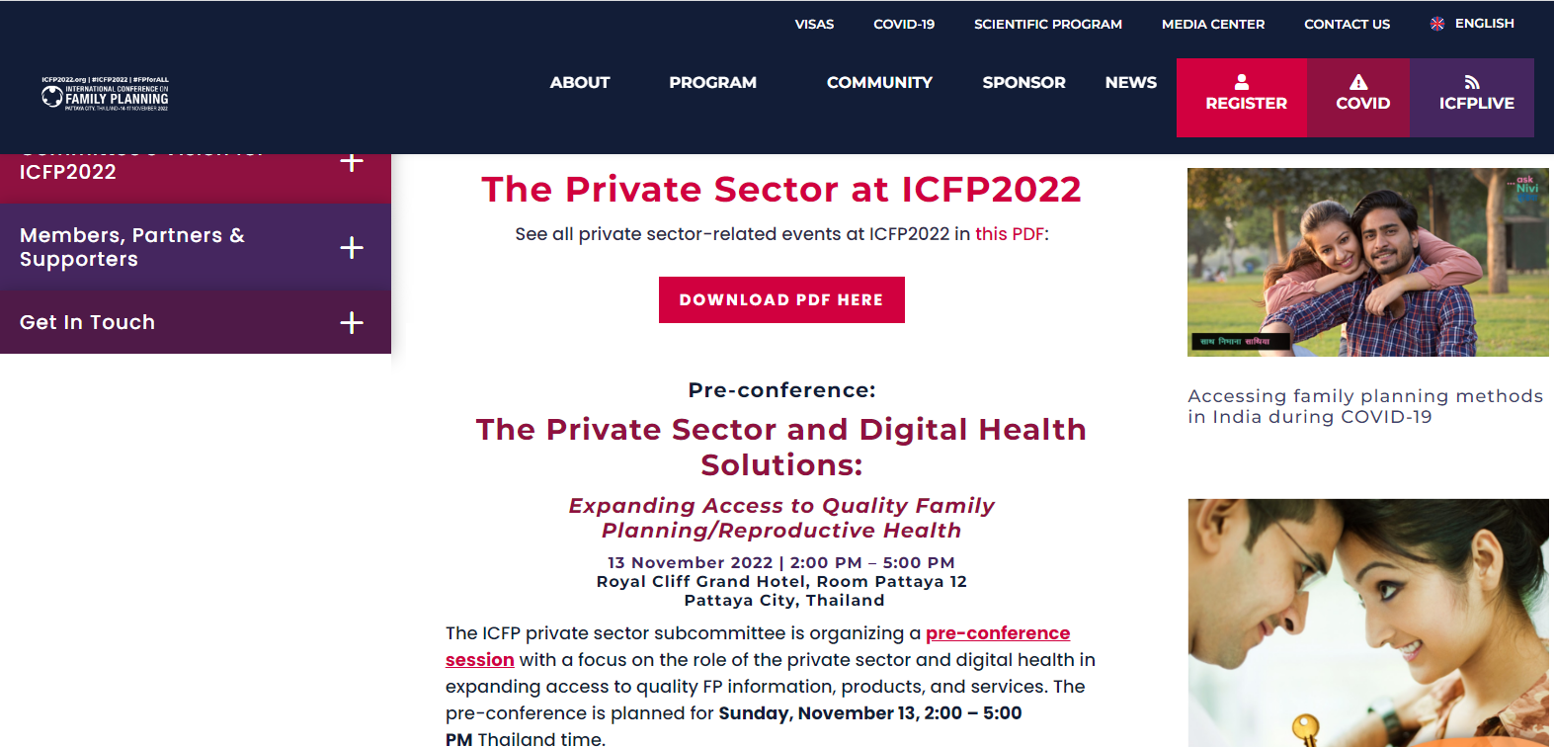
THANK YOU!
Visit the Private Sector Community Page at https://icfp2022.org/private-sector/

